Slide 1
Project on HOUSING: PRICE PREDICTION
Salman Pradhan
Submitted by

Slide 2

Required Libraries
1.Numpy
2.Pandas
3.Matplotlib
4.Seaborn
5.Scikit_learn

Slide 3
About Dataset
1.Loading dataset
2.Checking dimension
3.Checking columns
4.Checking column’s type
5.Statistical analysis
6.Checking Null values

Slide 4
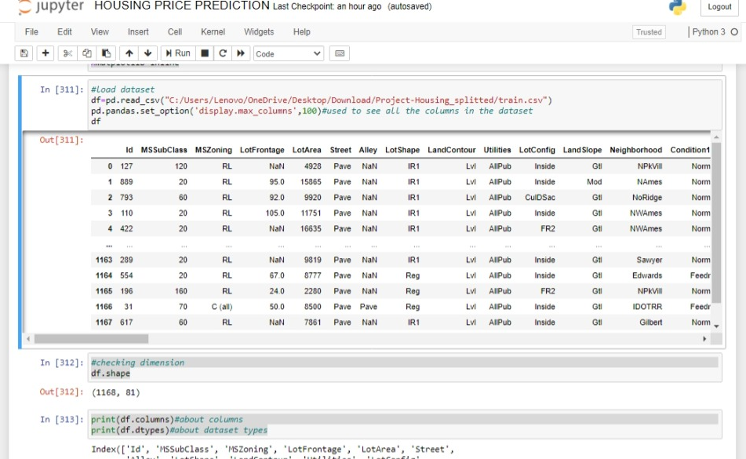
Dataset

Slide 5
From dataset we get informations as:
Dataset has so many null values.
Dataset has target variable column (SalePrice)so it is regression problem statement.

Slide 6
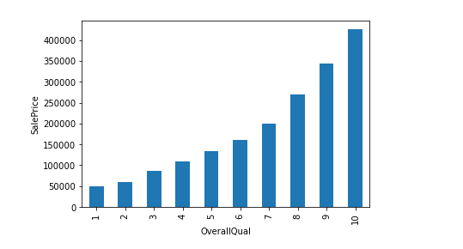
Data Analysis
OverallQual column varies directly with SalePrice.

Slide 7
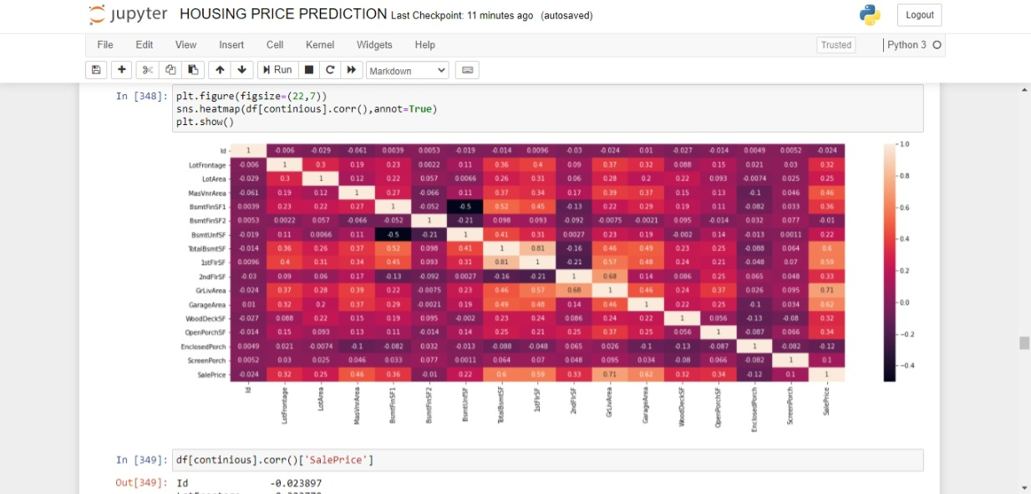
Checking Corelation
We have to check corelation of features against target column
GrLivArea,GarageArea is highly positively corelated to saleprice.

Slide 8
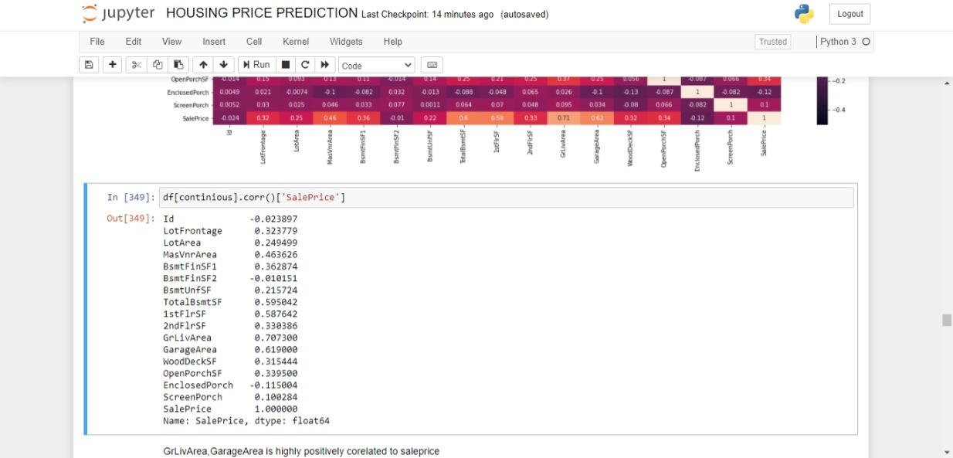

Slide 9
Features Selection
Id column has unique values,so we drop this column
Utilities column has only one value so we drop this column.

Slide 10
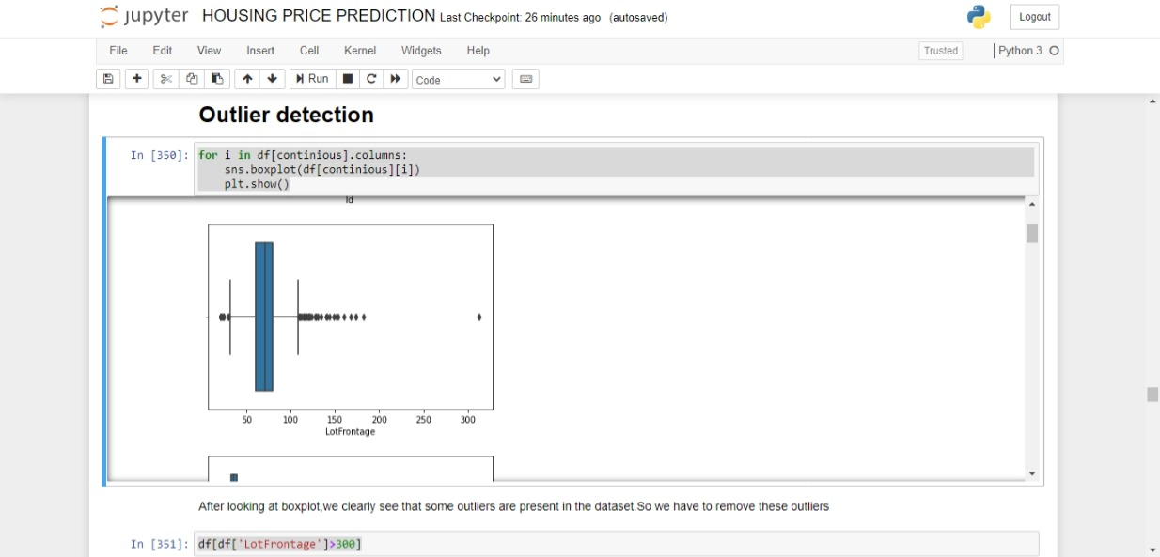
Checking Outliers
We have to visualize boxplot to check outliers present in dataset.
We use for loop to see boxplot of all numerical features.

Slide 11
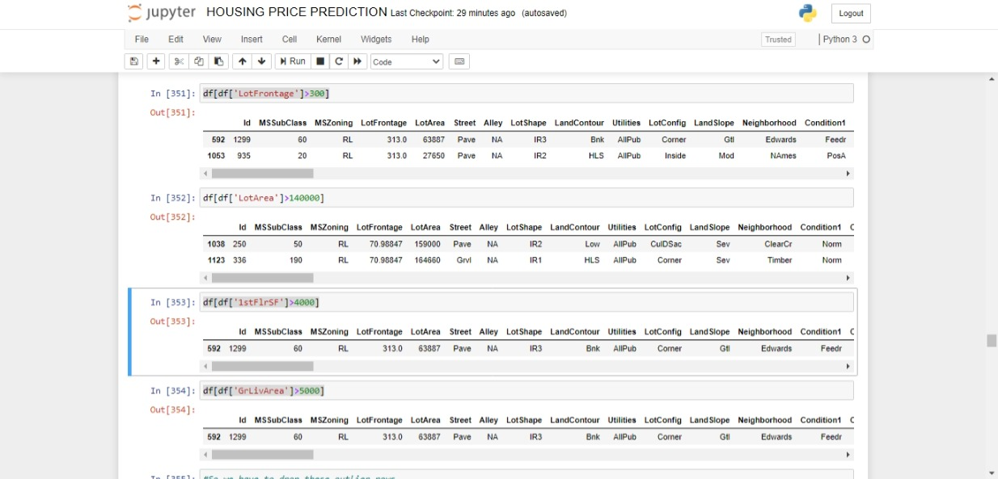
Removing Outliers
Looking at feature’s description and boxplot We remove outliers.
Outliers present in the dataset is of the dataset.

Slide 12
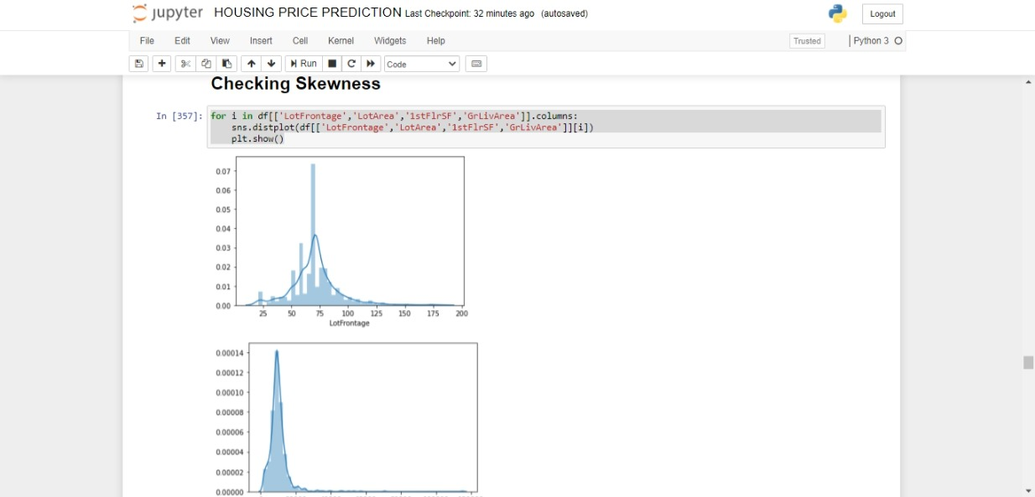
Checking Skewness
Skewness is present in some columns.

Slide 13
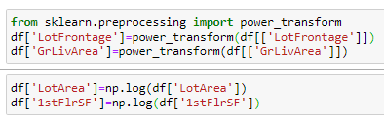
Skewness removal
We have to remove skewness by using log transform and power_transform method.

Slide 14
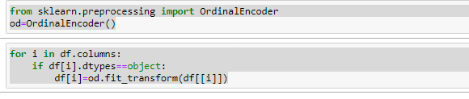
Convert catagorical features to numeric by using ordinalencoder.

Slide 15
Model building
Now we have to divide dataset in 90% training and 10% for testing purpose.
We have to use different algorithms and check it’s accuracy.

Slide 16
Algorithms used for model building:
1.LinearRegression
2.Lasso
3.Ridge
4.ElasticNet
5.RandomForestRegressor
6.ExtraTreesRegressor
7.GradientBoostingRegressor
8.XGBRegressor

Slide 17
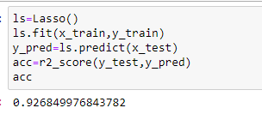
After using above algorithms we found that LassoRegression is the best model for the dataset.

Slide 18
Hyperparameter Tuning of Lasso Regression
After hyperparameter tuning of Lasso regression my accuracy score becomes 92.72% from 92.68%

Slide 19
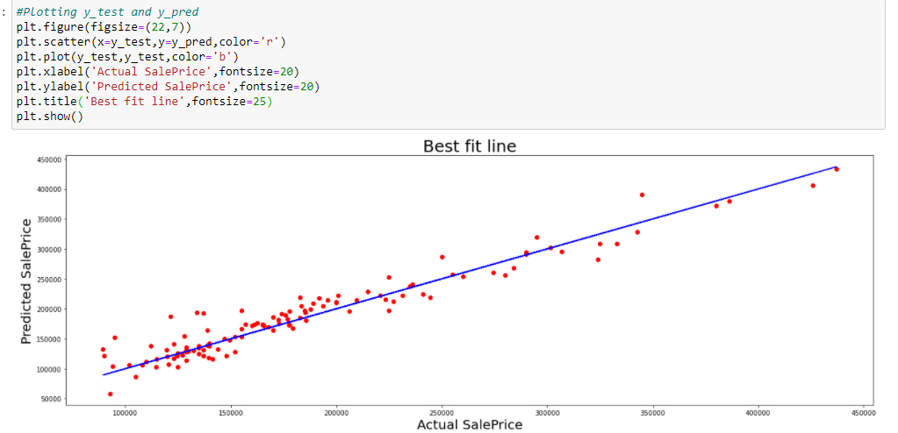
Best Fit Line

Slide 20
Preprocess test dataset

Slide 21
We have to load test dataset
We have to preprocess our test dataset for predicting by removing missing values,skewness and outliers present in the dataset.
After that we make our catagorical columns to numeric by using encoding technique.
Finally we do scaling our test dataset.Then predict output by using Lasso model.

Slide 22
Conclusion
I remove approximately 0.34% outliers from the train dataset which is pretty good,so that not much of information is lost.
I have used 90% of dataset for traing and remaining 10% of data for testing purposes.
As this usecase is regression problem statement,I have used various various regression algorithms to predict output such as LinearRegression,Lasso,Ridge,XGBRegressor,ElasticNet and ensemble technique like RandomForestRegressor,ExtraTreesRegressor,GradientBoostingRegressor.After using all algorithms I found that LassoRegression is best model for this dataset and accuracy_score is 92.72% which is high compared to other algorithms.

